Slide 1
AP Chapter 8
PR chapter 4
Chemical Bonds

Slide 2
8.1 Chemical Bonds
Chemical Bond: atoms or ions strongly attached to one another by forces that that make them function as a unit.
There are 3 types: Ionic, Covalent, and Metallic Bonds.
These are al Intramolecular forces

Slide 3
Why Bond at All?
Chemical bonds that form do so to achieve the lowest possible energy!! lower in energy than that of the separated atoms.
We determine the strength of a bond experimentally by measuring bond energy: the energy required to break a bond.

Slide 4
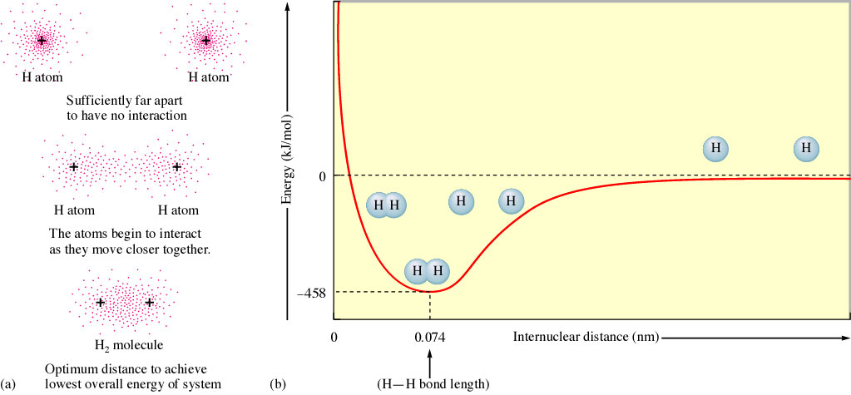
As the individual H atoms approach each other their energy level decreases and they become more stable (nonpolar covalent)
Bond length
Bond Energy
http://www.youtube.com/watch?v=Mo4Vfqt5v2A&feature=player_embedded

Slide 5
A Note on Strength & Energy
The energy it takes to break a bond is equal to the energy to make that bond.
The strength of a bond between two atoms is determined by the energy required to break the bond.

Slide 6
Bond Length and Strength
In general as the number of bonds between two atoms increases the bond length grows SHORTER and STRONGER
Bond | C - C | C = C | C Ξ C
Length (A) | 1.54 | 1.34 | 1.20
Energy KJ/mol | 348 | 614 | 839

Slide 7
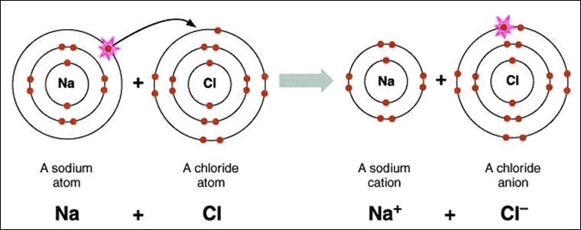
Ionic Bonds
Electrostatic force that exists between particles of opposite charge that results from a transfer of electrons from metals to non-metals.
Electronegativity difference between the metal and nonmetal is great enough for “e- transfer”

Slide 8
Common Features of Ionic Bonds
Ionic bonds form between metals and non-metals
In naming simple ionic compounds, the metal is always first, the non-metal second (ie. sodium chloride),

Slide 9
Common Features of Ionic Bonds
Ionic compounds dissolve easily in water and other polar solvents
In solution, ionic compounds easily conduct electricity
Ionic compounds tend to form crystalline solids with high melting points

Slide 10
Why Ionic Bonds Form
The energy of the interaction between the non-metal and the metal results in a lower energy than if the ions were not paired
Coulombs Law:
E = 2.31 x 10⁻¹⁹J*nm Q₁Q₂
r

Slide 11
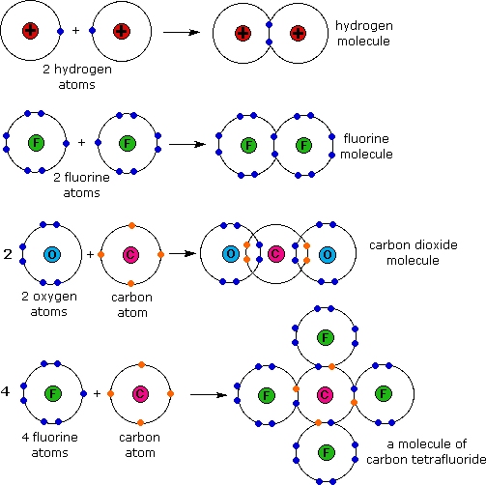
Covalent Bond
Sharing of electrons between two non-metals
Sharing can be equal (non-polar)
Sharing can be not equal (polar)

Slide 12
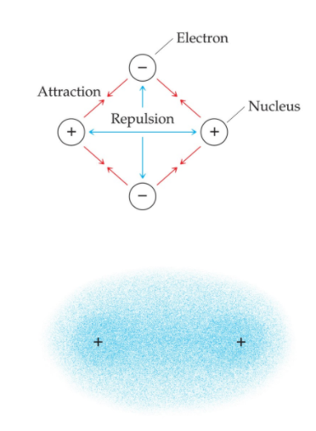
Covalent bonds continued
There are several electrostatic interactions in these bonds:
  Attractions between electrons and nuclei
  Repulsions between electrons
  Repulsions between nuclei

Slide 13
Features of Covalent Bond
Each atom shares its unpaired electron, both atoms are “tricked” into thinking each has a full valence of eight electrons.
Tend to be gases, liquids or low melting point solids, because the intermolecular forces of attraction are comparatively weak.

Slide 14
Features of Covalent Bond
Most covalent substances are insoluble in water but are soluble in organic solutions.
Poor conductors

Slide 15
Polar Molecules
To play movie you must be in Slide Show Mode
PC Users: Please wait for content to load, then click to play
Mac Users: CLICK HERE

Slide 16
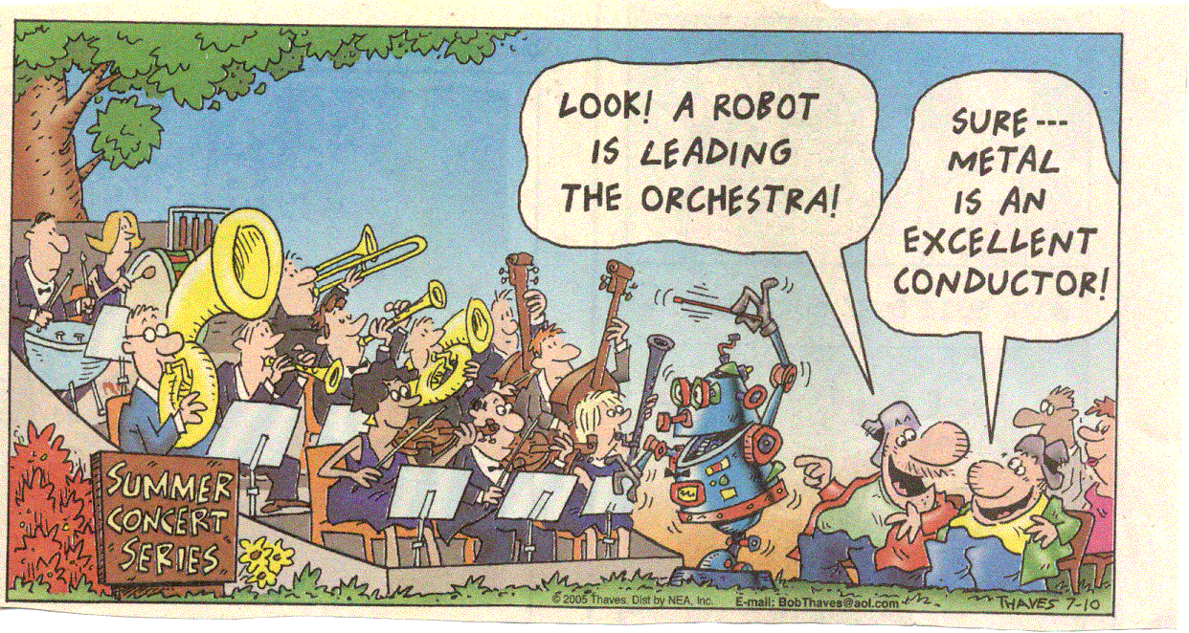
Metallic Bonds

Slide 17
Metallic Bonds
Bonds between metals (go figure!)
Metals have low ionization energies, thus they do not have a tight hold on their valence electrons.
Thus forming an "electron sea" that cements the positive nuclei together, and shields the positive cores from each other.

Slide 18
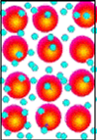
The e- move freely within molecular orbitals so each e- becomes detached from its parent atom. the e- are delocalized. The metal is held together by strong attractive forces between the positive nuclei and the delocalized e- . So bond strength increases with increased e-.
Fe bond strength> Mg bond strength due to more delocalized e-
e⁻

Slide 19
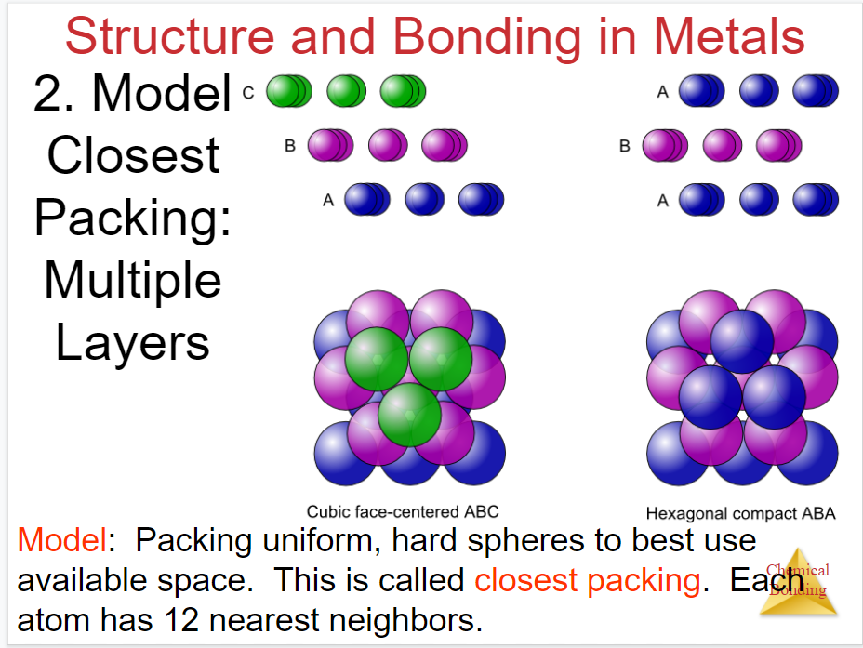

Slide 20
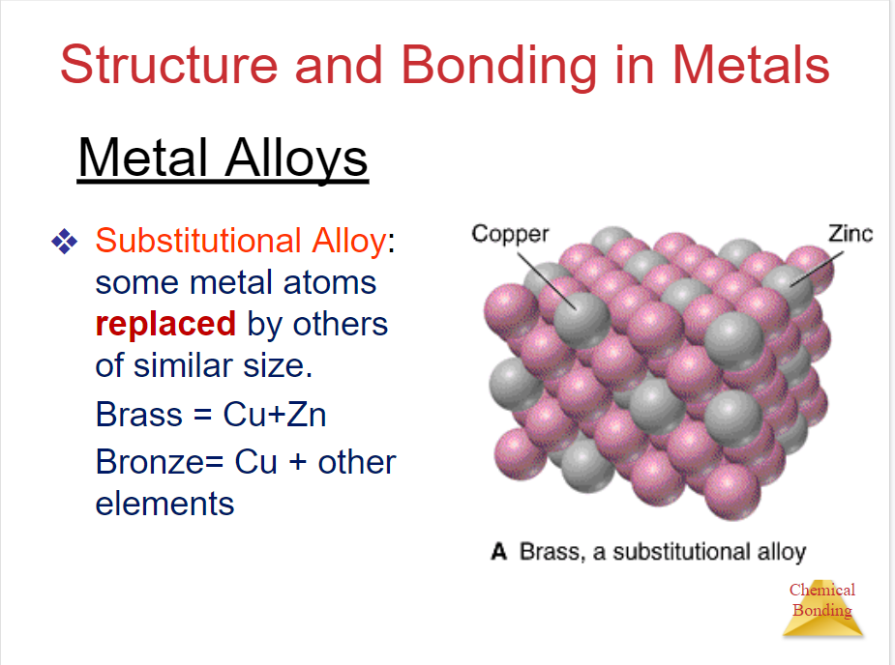

Slide 21
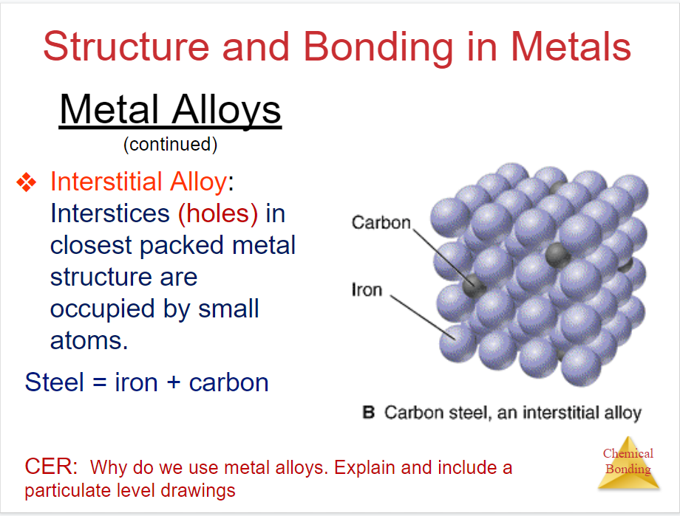

Slide 22
Features of Metallic Bonds
Metals are good conductors of heat and electricity. This is directly due to the mobility of the electrons.
The "cement" effect of the electrons determines the hardness of the metal. Some metals are harder than others; the strength of the "cement" varies from metal to metal.

Slide 23
More Features of Metallic Bonds
Metals are lustrous (shine)
Metals are malleable (can be flattened) and ductile (can be drawn into wires) because of the way the metal cations and electrons can "flow" around each other, without breaking the crystal structure.

Slide 24
8.2-8.3 Bond Polarity and Electronegativity
Bond polarity: describes the sharing of e- between atoms
Non-polar covalent bond: e- are shared equally between two atoms.
Polar: one atom exerts a great force of attraction for e- than the other atom. Creating a dipole moment.

Slide 25
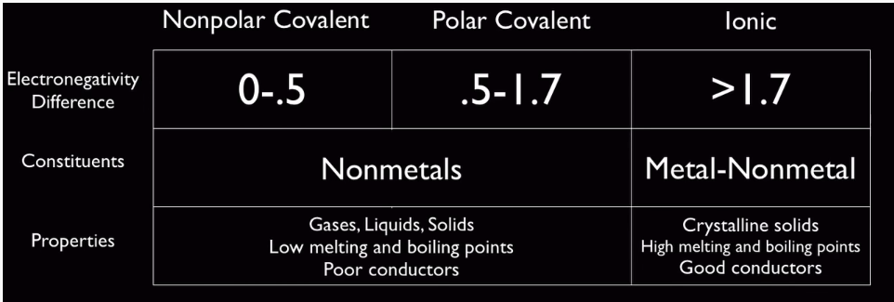
Electronegativity
Estimates whether a given bond will be
non-polar , polar, or ionic.
The ability of an atom in a molecule (bonded) to attract electrons to itself.
↑electronegativity ↑ability to attract e-

Slide 26
Calculating Electronegativity
The ability of an atom in a molecule to attract shared electrons to itself.
For the hypothetical molecule HX we will look at the bond energies
Δ = (H − X)_{actual} − (H − X)_{expected}

Slide 27
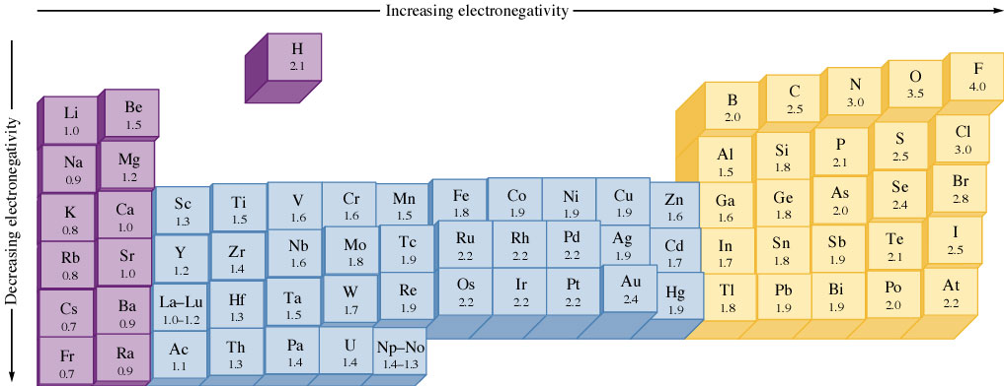
EN Trend
You will need to use the EN values in figure 8.3 pg 357 in your text for your homework.

Slide 28
CONCEPT CHECK!
If lithium and fluorine react, which has more attraction for an electron? Why?
In a bond between fluorine and iodine, which has more attraction for an electron? Why?
Notes:
The fluorine has more attraction for an electron than does lithium. Both have valence electrons in the same principal energy level (the 2nd), but fluorine has a greater number of protons in the nucleus. Electrons are more attracted to a larger nucleus (if the principal energy level is the same).
The fluorine also has more attraction for an electron than does iodine. In this case the nuclear charge of iodine is greater, but the valence electrons are at a much higher principal energy level (and the inner electrons shield the outer electrons).

Slide 29
CONCEPT CHECK!
What is the general trend for electronegativity across rows and down columns on the periodic table?
Explain the trend.
Notes:
Generally speaking, the electronegativity increases in going from left to right across a period because the number of protons increases which increases the effective nuclear charge. The electronegativity decreases going down a group because the size of the atoms increases as you go down so when other electrons approach the larger atoms, the effective nuclear charge is not as great due to shielding from the current electrons present.

Slide 30
EN and Type of bond
The greater the difference in EN between 2 atoms the more polar the bond is.
Table 8.1 pg 357
As covalent character decreases (zero difference EN)
ionic character increases (large difference in EN).

Slide 31
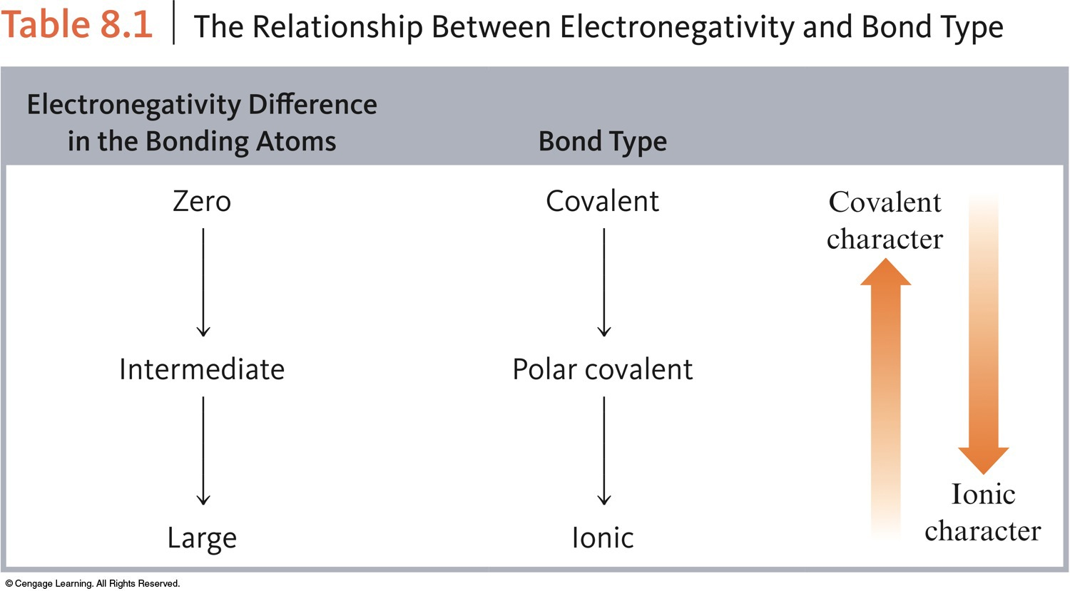

Slide 32
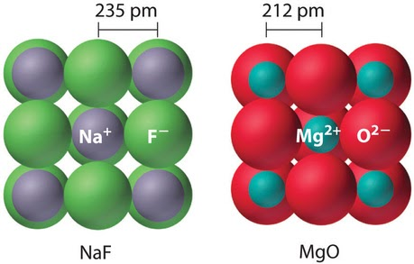
Strength of Ionic Compound due to Coulombic Force of Attraction
Coulomb’s Law allows us to understand the strength of interactions between cations and anions.
Interaction strength is proportional to the charge on each ion, larger charges lead to stronger interactions.
b. Interaction strength increases as the distance between the centers of the ions (nuclei) decreases, smaller ions lead to stronger interactions.
CER: Explain the difference in strength for NaF and MgO. How do their physical properties differ? How would yu describe NaCl relative to NaF? Use particulate level diagrams.
Notes:
Particulate diagrams AP college board : https://www.youtube.com/watch?v=ulkspirjClk

Slide 33
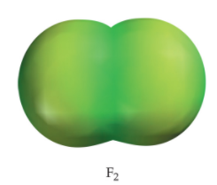

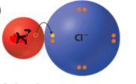
Example
Compound | F₂ | HF | KCl
EN difference | 4 – 4 = 0 | 2.1 – 4 = 1.9 | 0.8 – 3.0 = 2.2
Type of Bond | Non-polar covalent | Polar covalent | Ionic
Sharing | Equal | Unequal | Transfer of e-
* The bigger the difference the more polar

Slide 34
Determining Types of Bonds using Electronegativity
As the electronegativity difference between the atoms increases, the degree of sharing decreases.
If the difference in electronegativity is 2 or more, the bond is GENERALLY considered more IONIC than covalent.
If the electronegativity difference is between 0.1 and 2, the bond is a POLAR COVALENT.
If the electronegativity difference is ZERO, the bond is considered to be a NONPOLAR COVALENT.

Slide 35
8.3 Bond Polarity
Recall:
Bond polarity: describes the sharing of e- between atoms
Non-polar covalent bond: e- are shared equally between two atoms.
Polar: one atom exerts a great force of attraction for e- than the other atom. Creating a dipole moment.

Slide 36
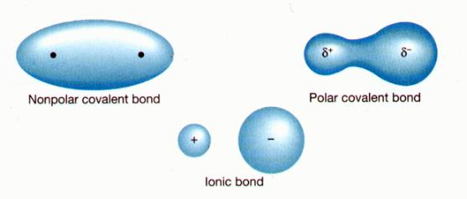
Difference is between 0.1 and 2
Zero difference in electronegativity
difference in electronegativity is 2 or more

Slide 37
EXERCISE!
Arrange the following bonds from most to least polar:
a) N–F O–F C–F
b) C–F N–O Si–F
c) Cl–Cl B–Cl S–Cl
a) C–F, N–F, O–F
b) Si–F, C–F, N–O
c) B–Cl, S–Cl, Cl–Cl
Notes:
The greater the electronegativity difference between the atoms, the more polar the bond.
C-F, N-F, O-F
Si-F, C-F, N-O
B-Cl, S-Cl, Cl-Cl

Slide 38
CONCEPT CHECK!
Which of the following bonds would be the least polar yet still be considered polar covalent?
Mg–O C–O O–O Si–O N–O
Notes:
The correct answer is N-O. To be considered polar covalent, unequal sharing of electrons must still occur. Choose the bond with the least difference in electronegativity yet there is still some unequal sharing of electrons.

Slide 39
CONCEPT CHECK!
Which of the following bonds would be the most polar without being considered ionic?
Mg–O C–O O–O Si–O N–O
Notes:
The correct answer is Si-O. To not be considered ionic, generally the bond needs to be between two nonmetals. The most polar bond between the nonmetals occurs with the bond that has the greatest difference in electronegativity.

Slide 40
Homework
PG 405 -406
#’s 13, 20, 22, 25, 26

Slide 41

Dipole Moments
Polar molecules have slight + and – charges at each end of the molecule. This is what allows them to easily attract ions and have strong intermolecular forces.
Symbol illustrates the shift in electron density. The arrow points in the direction of increasing density.
Think of the cross as a plus sign.
electronegativity = 2.1 3.0

Slide 42

Another way to illustrate bond polarity
*Use this one in class

Slide 43
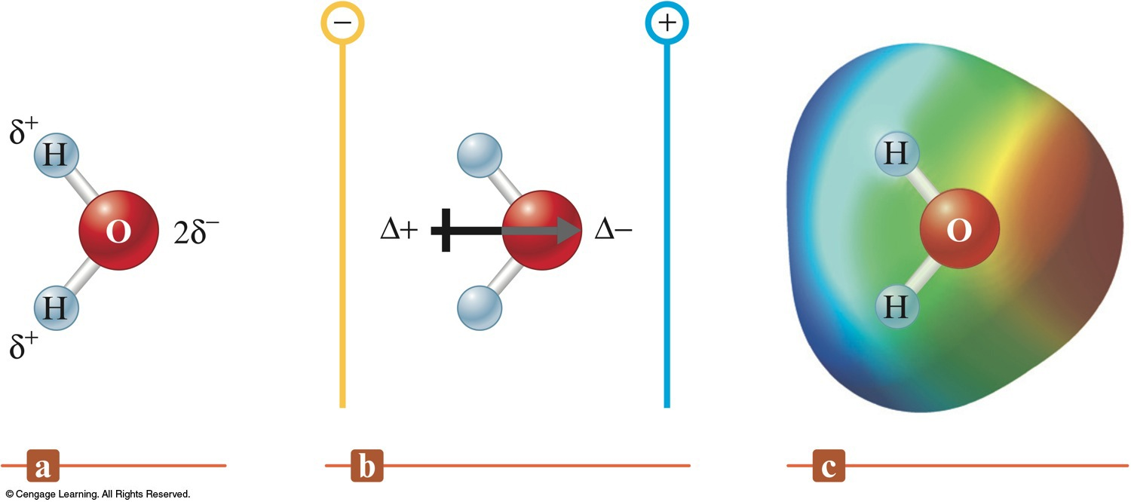
Dipole Moment

Slide 44
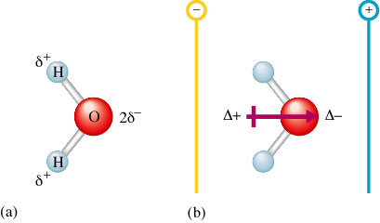
Polarity of Water

Slide 45
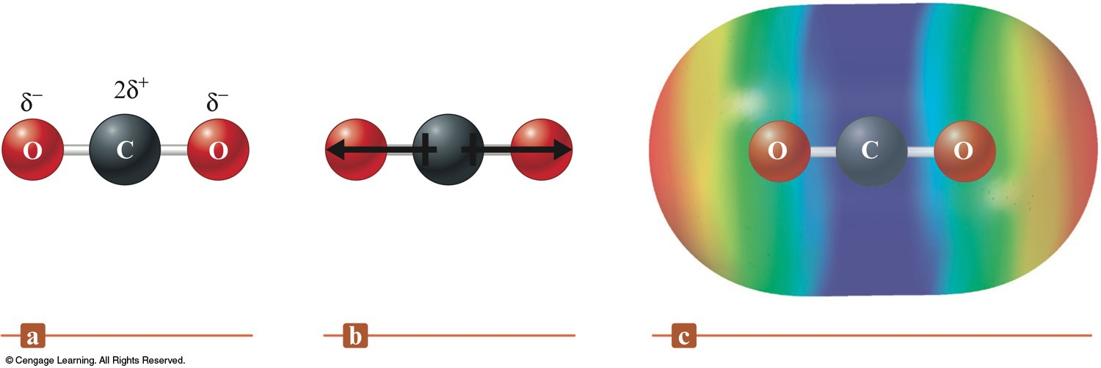
No Net Dipole Moment (Dipoles Cancel)

Slide 46
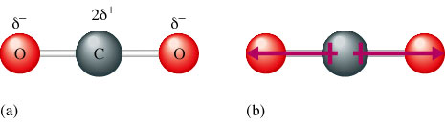
Cancellation of Opposed Polarities
180◦
When opposing polarities cancel out there is no dipolemoment
We must take into account molecular geometry and bond angle

Slide 47
Examples Of Illustrating Bond Polarity
HCl
H - Cl
EN 2.0 - 3.0 = 1.0 = polar covalent

Slide 48
Question
A. Calculate the difference in EN
B. Illustrate the bond polarity for the following molecules.
C. State if the bond is polar covalent, non-polar covalent, or ionic.
Cl₂ HBr H₂O

Slide 49
Cl – Cl
EN 3.0 3.0 = 0 = non-polar
H-Br
EN 2.1 2.8 (each) = 0.7 = polar
H₂O
2.0 3.5 = 1.4 polar

Slide 50



Symmetry and Dipole moments
It is possible for a molecule to have polar bonds but not have a dipole moment. Such molecules will have symmetry that will cancel out the bonds.
Linear molecules with identical bonds
Planar molecules with identical bonds 120°apart
Tetrahedral 4 identical bonds 109.5° apart

Slide 51
8.4 Ion: EC and Sizes
Achieving Noble Gas Electron Configurations (NGEC)
Two nonmetals react: They share electrons to achieve NGEC.
A nonmetal and a metal react (ionic compound): The valence orbitals of the metal are emptied (transferred) to achieve NGEC. The valence electron configuration of the nonmetal achieves NGEC.

Slide 52
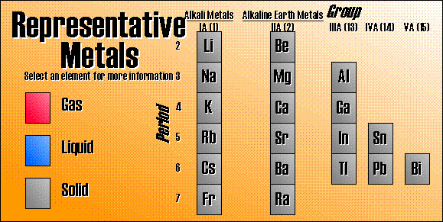
The representative metals contain 3 main groups, the alkali metals, the alkaline earth metals, and the post-transitional metals.

Slide 53
Isoelectronic Ions
Ions containing the same number of electrons
Ex: O²⁻, F⁻, Na⁺, Mg²⁺, Al³⁺
all have EC of [Ne]

Slide 54
Determining Size of Isoelectronic Ions
All have same # of e- so look at# of p⁺
Ion: O²⁻ , F⁻ , Na⁺ , Mg²⁺ , Al³⁺
p+: 8 9 11 12 13
As number of # p⁺ increases atomic size decreases due to increased attraction of e- to p⁺ in the nucleus.
Fig 8.8 pg 364

Slide 55
Ionic Radii
To play movie you must be in Slide Show Mode
PC Users: Please wait for content to load, then click to play
Mac Users: CLICK HERE

Slide 56
Homework
Pg 406
#’s 30, 32, 34, 35, 38

Slide 57
8.8 Covalent Bond Energies
In this section we will discuss…
  What gives bonds their strength and energy?
  How to calculate bond energy for a molecule
  - How to calculate bond energy for a RXN

Slide 58
Types of Bonds
Single bond: 2 atoms share 1 pair of electrons C-C
Double Bond: 2 atoms share 2 pairs o f electrons C=C
Triple Bond: 2 atoms share three pairs of electrons. CΞC

Slide 59
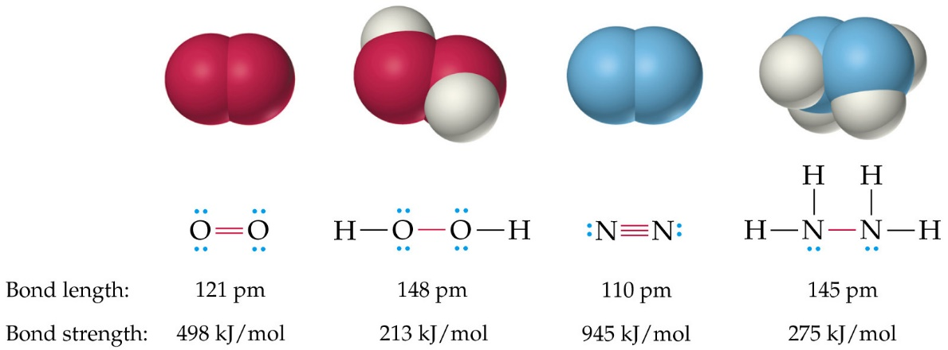
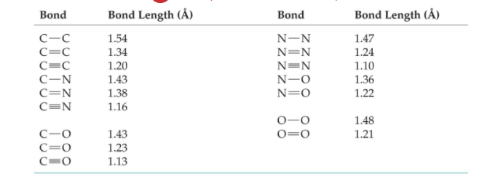
Bond Length table 8.4
The more bonds the shorter the bond length and the stronger the bond

Slide 60
Strength of Covalent Bonds
Bond strength = the degree of energy required to break that bond.
We call this degree of energy bond enthalpy , ΔH kJ/mol
ΔH is always positive.
Use table 8.4 on page 374 to determine bond energies. You will be given this on a test or quiz. (YES!)

Slide 61
Question
Use table 8.4 pg 374 to determine the bond enthalpy ΔH for the following bonds.
H-F
N=N
Which bond will be harder to break
I- Cl or Si - H

Slide 62
Answer
H – F = 567 KJ/mol
N = N = 418 KJ/mol
I – Cl = 208 KJ/mol
Si – H = 393 KJ/mol and will be harder to break.

Slide 63
Calculating Bond Energy for a RXN
For bonds to be broken energy must be added to the system (endothermic). For bonds to be formed energy must be released from the system (exothermic)
ΔH_{rxn}= sum of energy required to break old bonds (+) and plus energy release to form new bonds(-)
ΔH_{rxn}= ∑ (bonds broken) - ∑ (bonds formed)
reactants products
Yes it’s the opposite of heat of formation! Isn’t chemistry fun!

Slide 64
Break it down….
H₂ (g) + F₂ (g) → 2HF (g)
H-H + F-F → 2(H-F)
ΔH= (432 + 154) - 2(565)
= -544 kJ/mol

Slide 65
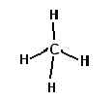
Try this on for size…
CH₄ + 2Cl₂ + 2F₂ → CF₂Cl₂ + 2HF + 2HCl
HINT: it may help to draw the molecules out

Slide 66
Answer
(1652+ 478+ 308) – (970 + 678+ 1130+ 854)
= -1194 kJ/mol

Slide 67
CONCEPT CHECK!
Predict ΔH for the following reaction:
Given the following information:
Bond Energy (kJ/mol)
C–H 413
C–N 305
C–C 347
891
ΔH = –42 kJ
Notes:
[3(413) + 305 + 891] – [3(413) + 347 + 891] = –42 kJ
ΔH = –42 kJ

Slide 68
Homework: bond energies
Pg 407-408
#’s 48, 50, 53, 54
For question 53 identify the functional groups on glucose

Slide 69
8.9 Localized Electron Model
Molecules are composed of atoms that have bound and unbound electron pairs.
Use Lewis structures to arrange electron pairs
2. Use VSEPR to predict molecular geometry
3.Describe orbitals of shared and lone pair e-’s.

Slide 70
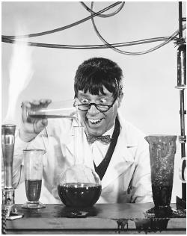
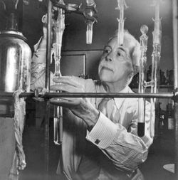
8.10 LE Model Part I: Lewis Structures

Slide 71
Valence Electrons
The electrons in the outer most shell of an atom that are involved in bonding.
The number of valence electrons an atom has is the group number.
  Example: Group 1A or IA = 1 valence electron

Slide 72
Lewis Structures
A method used to illustrate valence electrons and bonding between atoms.
  Example: Sulfur = Group 6 = 6 valence e⁻
  ● ●
  ● ●
  ● ●
S

Slide 73
Lewis Structure Rules
Remember Hund’s Rule when distributing your dots ( electrons).
Each side can hold 2 electrons (L,R, T, B)
With a max of 8 valence electrons (Octet Rule).

Slide 74
Octet Rule
Rule of eight!
Atoms tend to gain, share, or lose electrons until they have 8 electrons in their valence shell.
Note what the largest group number is.
Exception: Hydrogen = duet rule, rule of 2

Slide 75
8.2 Ionic Bonding
Look at the balanced reaction of sodium (metal) and chloride (non-metal).
Na(s) + 1/2Cl₂(g) NaCl (s)
Note: ΔH_{f} = -410.9 kJ
There for: we have an enthalpy change that is exothermic (exo = out)

Slide 76
Lewis diagram of NaCl
Na + Cl = Na⁺ + Cl⁻
Cl gains Na’s electron

Slide 77
Na(s) + 1/2Cl₂(g) NaCl (s)
Note: ΔH_{f} = - 410.9 kJ exothermic
But we are losing an e -, ionization energy should have a + ΔH_{f} or endothermic. (Ch 7 notes).
When a NON-metal (Cl) gains an e- the process is generally negative like this. (ch 7 notes).

Slide 78
Question
Draw the Lewis structure for:
C
Ca
Al

Slide 79


Covalent Bonding

Slide 80
Illustrating Covalent Bonds
Each pair of shared electrons is a line.
    C – C
Unshared electrons are dots.

Slide 81
Types of Bonds
Single bond: 2 atoms share 1 pair of electrons C-C
Double Bond: 2 atoms share 2 pairs o f electrons C=C
Triple Bond: 2 atoms share three pairs of electrons. CΞC

Slide 82
Question
What type (number) of bonds hold the following molecules together.
Cl₂
CO₂
N₂

Slide 83

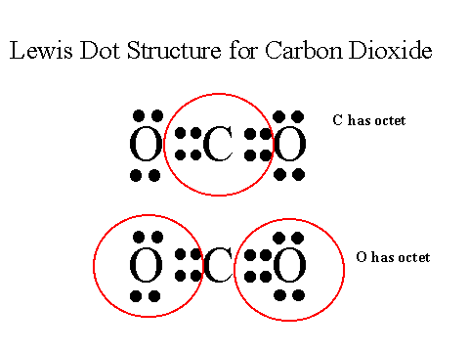

Answer
Cl-Cl
O = C = O
N Ξ N

Slide 84
Lewis Structure Rules for Molecules
1. Add up all the valence e- for all the atoms in the molecule.
ex: PCl₃
P = 5
Cl = 7 x 3 = 21
Total of 26e-
* For a molecule with a + charge subtract and e- , for a molecule with a – chg add and e- to the total. Ex: 2- charge add 2 e-

Slide 85
2. Write the symbol for the atoms to show which atoms are connect to which using a single line (-).
The central atom is usually written 1st in the molecular formula. PCl₃
Used e- Talley
26 e-
6 e-
20e- left
Cl
P
Cl
Cl

Slide 86
3. Complete the octet of the atoms bonded to the central atom.
Used e- Talley
20 e-
18 e-
2 e- left
Cl
P
Cl
Cl

Slide 87
4. Place any e- left on the central atom even if doing so results in more than a full octet
Used e- Talley
2 e-
2 e-
0 e- left
Cl
P
Cl
Cl

Slide 88
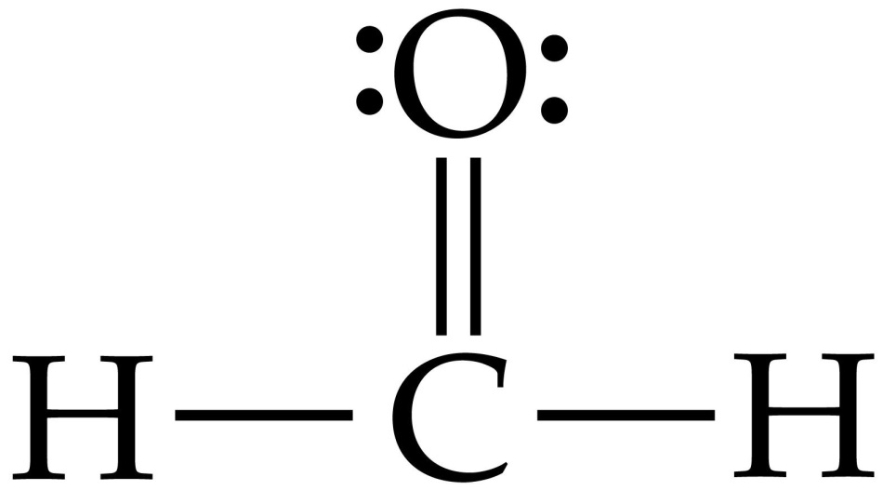
5. If there are not enough e- to give the central atom a full octet try multiple bonds.

Slide 89
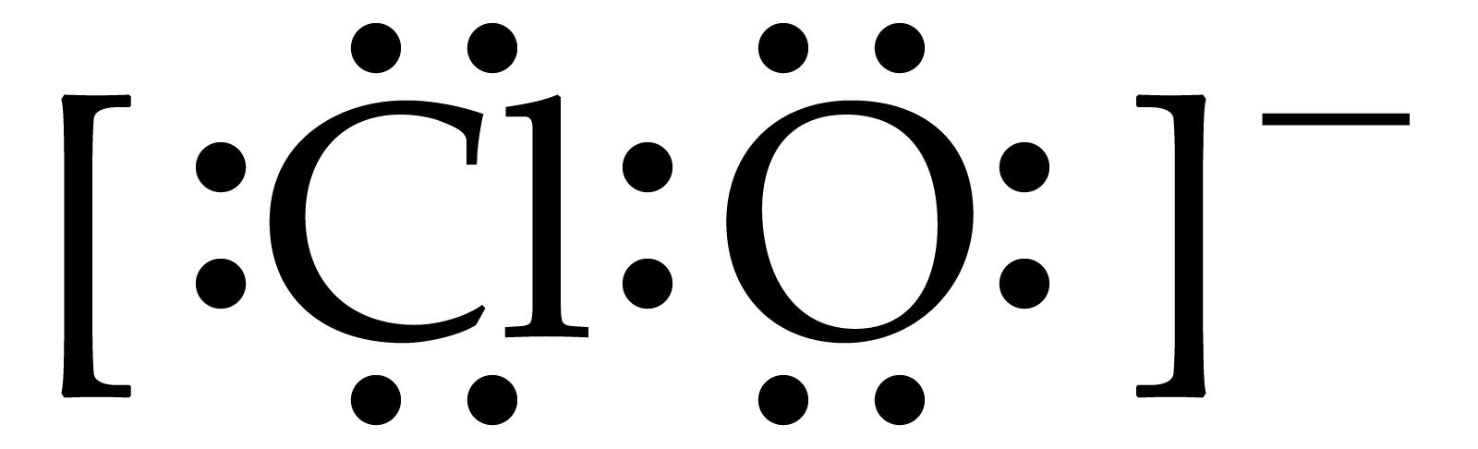
6. If there is a charge on the molecule you need to place the Lewis structure in brackets and show the charge.

Slide 90
White Boards
As a class lets do CH₂Cl₂

Slide 91
Question
Draw the Lewis structure for the following.
C₂H₄
BrO₃⁻
ClO₂⁻
PO₄³⁻

Slide 92

8.11 Three Exceptions to the Octet Rule
Molecules with an odd number of e-
NO = 11Ve-
or
N = O

Slide 93
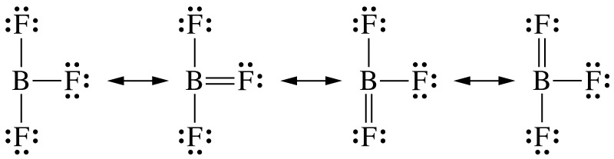
2. Molecules where an atom has less than an octet. This occurs most with Boron and Beryllium. BF₃ = 24 Ve-
For these two atoms (Be & B) it is more stable with out a full octet than with a double bond.

Slide 94
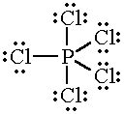
3. Molecules which an atom has more than an octet. PCl₅ = 40 Ve-

Slide 95
Resonance
Placement of atoms is the same but placement of electrons is different.
Used when 2 or more Lewis structures are usually good descriptions of a single model.

Slide 96
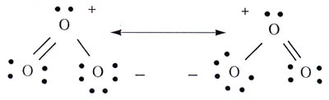
Resonance of Ozone 0₃

Slide 97
Question
Draw the three resonance structures for SO₃

Slide 98
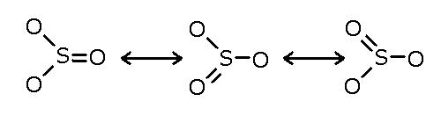
Answer

Slide 99

Delocalized Bonding
Occurs only when pi bonds have resonance.
The easiest way to spot delocalized electrons is to compare electron locations in two resonance forms. If a pair appears in one place in one form, and in a different place in another form, the pair is delocalized.

Slide 100
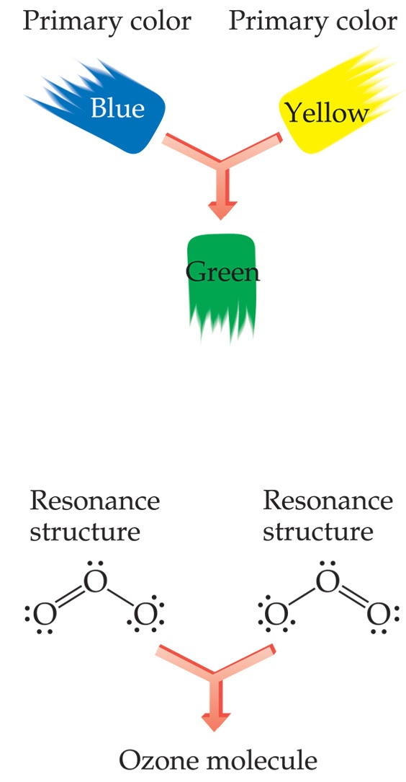

Slide 101
Homework Lewis and Resonance
DO NOT CHEAT IN THE BACK OF YOUR BOOK: this is good AP practice so get it while you can.
Pg 408-409
#’s 63, 64, 65, 67, 69, 73
Bond length table 8.5 pg 374
Bond energy table 8.4 pg 373

Slide 102
8.12 Formal Charge
Formal charge is an accounting procedure.
It allows chemists to determine the location of charge in a molecule as well as compare how good a Lewis structure might be.

Slide 103
We calculate the formal charge for each atom in a molecule.
We can check our work by adding the FC’s up and then we get the charge of the molecule.
Formal Charge =
(# Ve-) – (# non-bonding e- + ½ # bonding e-)

Slide 104
Calculating formal charge (FC)
1. Draw the Lewis Structure
    CN⁻
    [ : C Ξ N : ] ⁻
C = 4Ve- + N = 5Ve- + 1e- for – chg = 10e-

Slide 105
2. Assign unshared e- to the atom they are bound to.
    [ : C Ξ N : ] ⁻
2 non-bonding e-
2 non-bonding e-

Slide 106
3. Half of the bonding e- are assigned to each atom.
    [ : C Ξ N : ] ⁻
2 non-bonding e-
6e- in triple bond/2 = 3
2 non-bonding e-
6e- in triple bond/2 = 3

Slide 107
4. Apply the FC equation.
    [ : C Ξ N : ] ⁻
Formal Charge =
(# Ve-) – (# non-bonding e- + ½ # bonding e-)
2 non-bonding e-
6e- in triple bond/2 = 3
3 + 2 = 5 e- in Lewis
N = 5Ve-
FC for N = 5 – 5 = 0
2 non-bonding e-
6e- in triple bond/2 = 3
3 + 2 = 5 e- in Lewis
C = 4Ve-
FC for C = 4 – 5 = -1

Slide 108
5. Repeat this process with each possible Lewis Structure for that molecule (aka resonance structure).
Question: How many resonance structures are there for NCS⁻

Slide 109
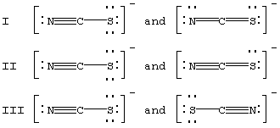
Ve- 5 4 6 5 4 6
- 5 4 7 6 4 6 __________________________________________________
0 0 -1 -1 0 0
d
d
d
d
d
[ N - C Ξ S ]-
Ve- 5 4 6
- 7 4 5 _______________________________ -2 0 1

Slide 110
Question
Calculate the formal charge for all of the resonance structures of NCO⁻.

Slide 111
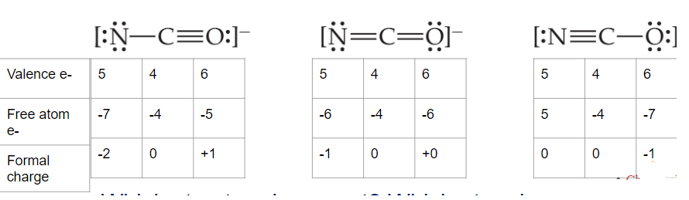
Which structure is correct? Which atom is more electronegative N or O?

Slide 112
Homework: Formal Charge
Pg 409
#’s 75, 77

Slide 113
8.13 Molecular Shapes VSEPR
Lewis structures show the number of bonds but not the actual shape of the molecule.
Molecules are three dimensional
The overall shape of the molecule is determined by the angles at which the atoms bond to each other.

Slide 114
VSEPR
To play movie you must be in Slide Show Mode
PC Users: Please wait for content to load, then click to play
Mac Users: CLICK HERE

Slide 115
VSEPR: Two Electron Pairs
To play movie you must be in Slide Show Mode
PC Users: Please wait for content to load, then click to play
Mac Users: CLICK HERE

Slide 116
VSEPR: Three Electron Pairs
To play movie you must be in Slide Show Mode
PC Users: Please wait for content to load, then click to play
Mac Users: CLICK HERE

Slide 117
VSEPR: Four Electron Pairs
To play movie you must be in Slide Show Mode
PC Users: Please wait for content to load, then click to play
Mac Users: CLICK HERE

Slide 118
VSEPR: Iodine Pentafluoride
To play movie you must be in Slide Show Mode
PC Users: Please wait for content to load, then click to play
Mac Users: CLICK HERE

Slide 119
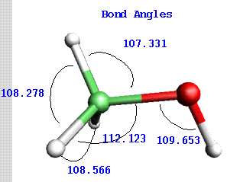
Bond Angles
Are the angles made by the bonds from the nuclei of one atom to the nucli of another atom.

Slide 120
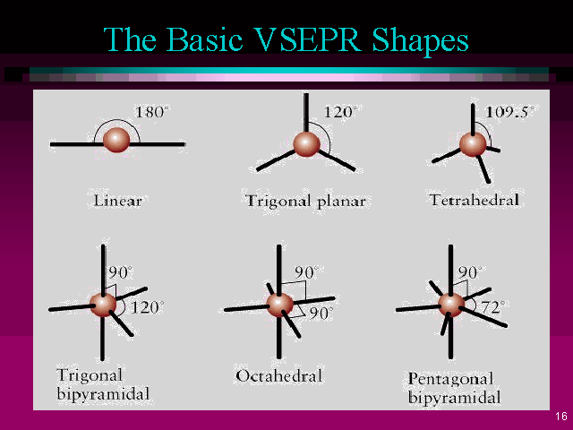

Slide 121
VSEPR
Valence Shell Electron Pair Repulsion
  The model that accounts for the geometry arrangement of shared and unshared electron pairs around a central atom in terms of the repulsion between electron pairs.

Slide 122
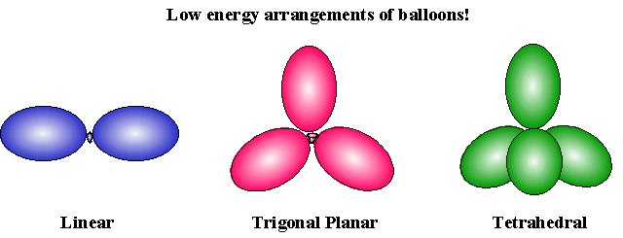
9.2 VSEPR
Balloon Demo
  GET OUT OF MY WAY!!!!! = REPULSION

Slide 123
The Best Shape
The best geometry for a molecules is one that minimizes repulsion between lone pairs and bonded pairs or electrons.
You are responsible to know all the information on the handout.
        Sad but true!

Slide 124
Homework
9.1 Fill in molecular geometry table columns C and G using your text

Slide 125

Quick VSEPR Lesson
Electron Domain = electron pairs bound to the central atom.
  Cl— C – Cl
Nonbonding Domains = lone pairs bound to the central atom

Slide 126
Quick VSEPR Lesson cont.
Note we only care about bonds and lone pairs on a designated atom (typical the central atom unless other wise noted)
2. Lone pairs, single, double, triple bonds all count as one domain ONLY.

Slide 127
Steps to Using VSEPR to Predict Molecular Shape
Draw Lewis Structure
Count the total # of bonding domains (electron and lone pairs on designated atom only).
Arrange the bonding domains so there is the least repulsion. (my table will help)
Use the arrangement to determine the molecular geometry.

Slide 128

180°
CO₂
C 4
O 6
O 6
16 e-
2 electron bonding domains
0 non-bonding domains
electron pairs around the central atom
(column A)
Use your table 9.2- 3
# of bonding domains (2) tells the electron pair arrangement of = linear (B/D)
# non-bonding domains (0) tells us the molecular geometry = linear (E/F)

Slide 129
Question
What is the molecular geometry of
NH₃

Slide 130

N 5
H 1
H 1
H 1
8
3 electron bonding domains
1 non-bonding domains
4 electron pairs around the central atom (A)
~109.5°
Use your table
# of e- around central atom 4 (A)
tells the electron pair arrangement of = Tetrahedral (B)
# of bonding domains 3 (D)
# of non-bonding 1 (E)
tells us the molecular geometry = Trigonal Pyramid

Slide 131
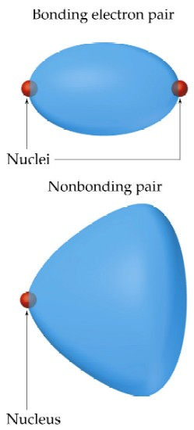
Effect of bonding and non-bonding electrons
e- domains for nonbonding e- pairs (lone pairs) exert a greater force of repulsion on adjacent e- domains and they tend to compress bond angles distorting them.
Multiple bonds exert a greater repulsion force on adjacent e- domains than single bonds distorting bond angles.

Slide 132
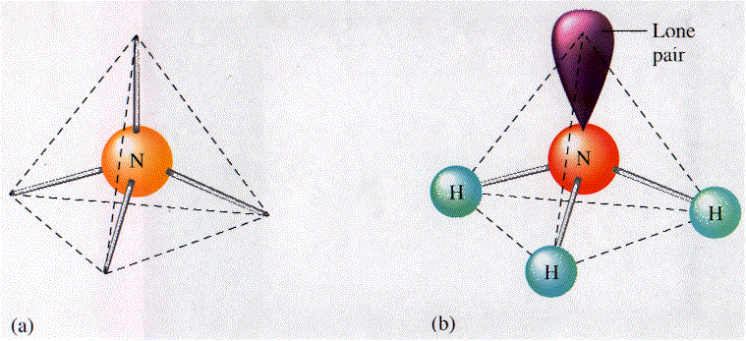
Electron Pair Arrangement Molecular Geometry
4 pairs around central atom 3 bonding pairs
Tetrahedral (A) 1 nonbonding =
Trigonal pyramid (D/E/F)
107.0

Slide 133
Molecular shape and molecular polarity
Bond Polarity: measures how equally the electrons in a bond are shared between two atoms.
(as the difference in electron negativity between the two atoms increases so does the bond polarity.)

Slide 134
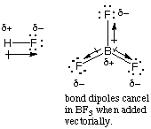
NOTE: For molecules with more than two atoms the dipole moment depends on both polarities of the individual bonds and the geometry of the molecule.

Slide 135
Dipoles are vector quantities. This means that the a direction (the arrow indicates this) and a magnitude (the greater the difference in EN the greater the magnitude).

Slide 136
CONCEPT CHECK!
Determine the shape for each of the following molecules, and include bond angles:
HCN
PH₃
SF₄
HCN – linear, 180º
PH₃ – trigonal pyramid, 109.5º (107º)
SF₄ – see saw, 90º, 120º
Notes:
HCN – linear, 180º
PH₃ – trigonal pyramid, 107º
SF₄ – see saw, 90º, 120º

Slide 137
CONCEPT CHECK!
Determine the shape for each of the following molecules, and include bond angles:
O₃
KrF₄
O₃ – bent, 120º
KrF₄ – square planar, 90º, 180º
Notes:
O₃ – bent, 120º
KrF₄ – square planar, 90º, 180º

Slide 138
CONCEPT CHECK!
True or false:
A molecule that has polar bonds will always be polar.
-If true, explain why.
-If false, provide a counter-example.
Notes:
False, a molecule may have polar bonds (like CO₂) but the individual dipoles might cancel out so that the net dipole moment is zero.

Slide 139
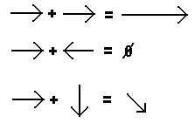
Polarity of molecules
Dipoles are vector quantities. They have a direction as well as a magnitude.
When vectors are added together one has to take into account the direction.
Two equal vectors pointing in the same direction add together to give one with twice the magnitude.
Two vectors pointing in opposite directions cancel and the total is zero.
Two vectors at different directions are added the resultant total vector is a combination of their direction and magnitude.

Slide 140
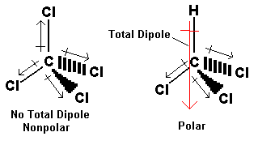
Determining Polarity
If equal dipoles are arranged symmetrically, then...
The total polarity is zero (NONPOLAR)
If dipoles are arranged asymmetricaly or are unequal, then...
The total polarity is greater than zero (POLAR)

Slide 141
Steps to determine symmetry
Draw the molecular shape of the molecule.
Describe the polar bonds with arrows pointing toward the more electronegative element. Use the length of the arrow to show the relative polarities of the different bonds.
(A greater difference in electronegativity suggests a more polar bond, which is described with a longer arrow.)
Decide whether the arrangement of arrows is symmetrical or asymmetrical
If the arrangement is symmetrical and the arrows are of equal length, the molecule is nonpolar.
If the arrows are of different lengths, and if they do not balance each other, the molecule is polar.
If the arrangement is asymmetrical, the molecule is polar.

Slide 142
Question
Decide whether the molecules represented by the following formulas are polar or nonpolar. (You may need to draw Lewis structures and geometric sketches to do so.)
CO₂ b. OF₂ c. CCl₄ d.CH₂Cl₂
e. HCN

Slide 143

Answer A
C-O bonds are polar, but the symmetrical arrangement of these bonds makes the molecule nonpolar.
If we put arrows into the geometric sketch for CO2, we see that they exactly balance each other, in both direction and magnitude. This shows the symmetry of the bonds.

Slide 144

The electronegativities of oxygen and fluorine, 3.44 and 3.98, respectively, produce a 0.54 difference that leads us to predict that the O-F bonds are polar. The molecular geometry of OF₂ is bent. Such an asymmetrical distribution of polar bonds would produce a polar molecule.

Slide 145

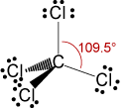
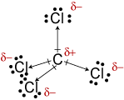
The molecular geometry of CCl₄ is tetrahedral. Even though the C-Cl bonds are polar, their symmetrical arrangement makes the molecule nonpolar.

Slide 146

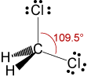
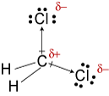
The difference in electronegativity for the H-C bonds tells us that they are essentially nonpolar. The 0.61 difference in electronegativity for the C-Cl bonds shows that they are polar.
The polar bonds are asymmetrically arranged, so the molecule is polar.
(Notice that the Lewis structure above incorrectly suggests that the bonds are symmetrically arranged)

Slide 147
The electronegativities of hydrogen, carbon, and nitrogen are 2.20, 2.55, and 3.04. The 0.35 difference in electronegativity for the H-C bond shows that it is essentially nonpolar.
The 0.49 difference in electronegativity for the C-N bond tells us that it is polar. Molecules with one polar bond are always polar.

Slide 148
Homework: VSPER
Pg 409-410
Predict the molecular structure and bond angles for the molecule or ion in question
63 and 67 (you drew these already in past homework… hope you checked it with the class!)
83, 86, 91, 92,95

Slide 149
9.1 Localized Electron Model Theory
A theory that assumes that a covalent bond is formed by the overlap of 2 atomic orbitals, each of which contains an unpaired electron.
The higher the amount of overlap, the stronger the bond formed.

Slide 150
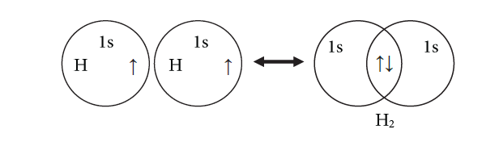
Orbital Overlap
Sigma Bond
The overlap of orbitals allows the electrons in a bond to share the common space between nuclei
As in a Lewis structure the two electrons in a bond are shared by two atoms.

Slide 151
Hybridization
The mixing of atomic orbitals to form new types of orbitals called hybrid orbitals
By the use of hybrid orbitals, the bonding in certain covalent species can be described in terms of orbital overlap.
Hybridization can also describe geometry based on the repulsion of the hybrid orbitals.

Slide 152
Hybridization
Total number of electron pairs on the central atom (σ + lone pairs) | Hybridization
2 linear 180° | sp
3 Triganal planer 120° | sp²
4 Tetrahedral 109° | sp³
5 Triganal bypiramidal 120 ° 90° | sp³d
6 Octahedral 90° | sp³d²

Slide 154
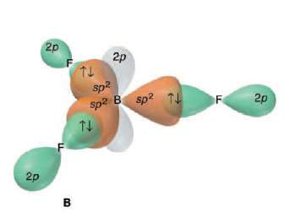

Slide 158



Slide 159
IR Spectrum
Hybridization
http://www.wwnorton.com/college/chemistry/chemistry3/ch/09/chemtours.aspx

